Slide 1


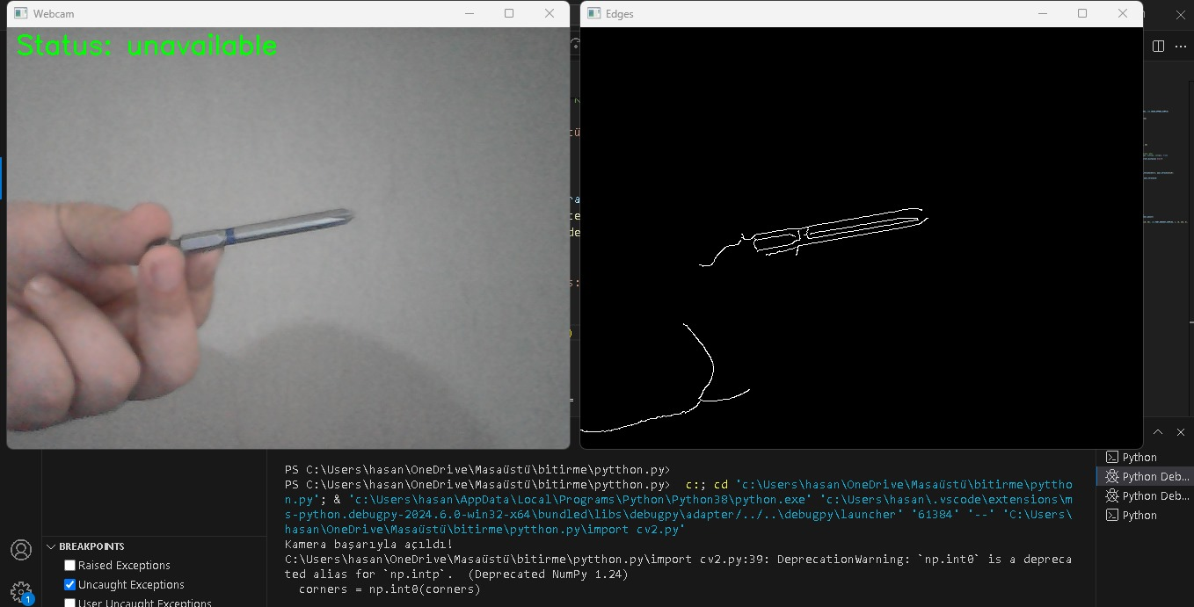
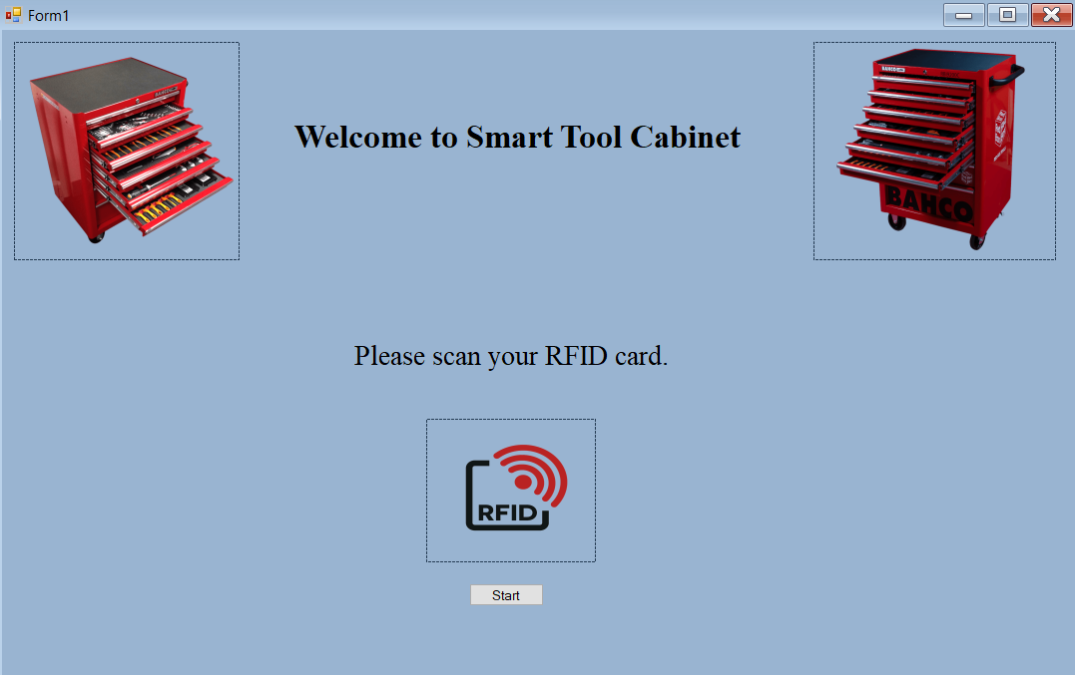
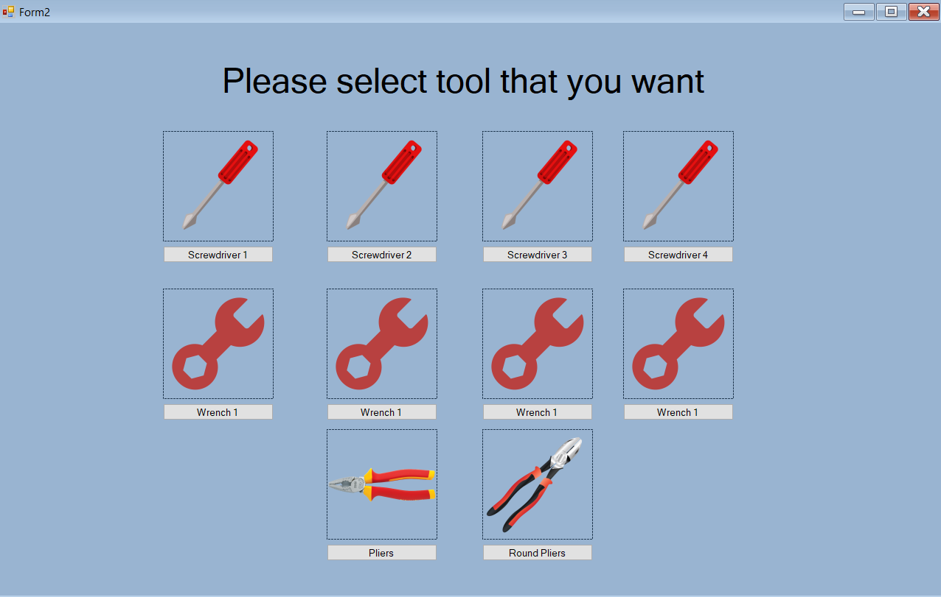
Smart Tool Cabinet
Mehmet Berke PARLAT
Hasan ÜNLÜ
Metehan SARIOĞLAN
Supervisor: Asst. Prof. Dr. Nail AKÇURA
Abstract
The Smart Tool Cabinet project revolutionizes tool management in industrial and workshop settings through a C# Windows Forms application integrated with advanced image processing techniques. This system enhances efficiency, security, and accessibility by using real-time image recognition to monitor tool status and condition, automatically detecting presence, absence, or misplacement. The application features a comprehensive database cataloging tool specifications, maintenance history, and current locations within the cabinet. By incorporating intuitive design principles, the interface prioritizes ease of navigation and user interaction, ensuring automated tracking and alerts for discrepancies and worn tools, ultimately streamlining tool inventory management.
1. Introduction
The Smart Tool Cabinet project is a sophisticated system for industries and workshops to manage and organize tools efficiently. Developed as a C# Windows Forms application, it enhances tool usage, reduces misplacement, and improves workflow for technicians and engineers. The intuitive interface allows administrators to monitor tool inventory, classify tools, and track usage in real-time using RFID or barcode scanning technologies.
In this project, image processing techniques are used for quality control within the smart tool cabinet. These techniques involve using computational algorithms to process digital images, allowing the system to monitor tool wear and condition accurately. Tool wear is an inevitable process that can lead to poor surface finish and tool breakage, causing costly downtime and damaged components. Therefore, a Tool Condition Monitoring (TCM) system is essential for proactive maintenance.
Current industry methods for examining tool wear often rely on expert opinion and are qualitative, leading to variability and information loss. This project aims to develop a reliable, automatic wear characterization system that integrates image acquisition and processing methods. By analyzing different levels of tool wear, the system quantifies repeatability and reproducibility, helping reduce quality costs and avoid downtime. Monitoring tool wear and controlling its evolution optimizes machining processes, prolongs tool life, and prevents product rejection due to tool condition deterioration. The interface utilizes digital images of cutting tools detected by a camera, allowing real-time tool wear evaluation through intelligent image data processing.
2. Interface Design
An elaborate flowchart was created to map out the application's user interface stages, detailing user interactions, navigation routes, and primary features. An initial welcome screen design was also developed to engage users and guide them on how to proceed.
For software development, a search was performed, C# and Windows Forms Application due to C#'s strong object-oriented features and Windows Forms' graphical user interface toolkit. This combination allowed us to develop complex functionalities with clarity and ease of maintenance while creating a visually appealing, user-centric interface. C#'s integration with various libraries and APIs extended our application's functionality, enhancing performance and responsiveness.
The interface was designed to integrate an RFID reader, user profiles, visual representations of tools, and real-time data from Arduino and micro switchs. RFID technology efficiently tracks and manages tools, linking them to user profiles. Images of tools help users easily identify and select equipment, while Arduino and pressure sensors provide immediate feedback on tool handling and usage. This design ensures a comprehensive, user-friendly, and advanced tool management experience.
Figure 1: Windows Forms Application
3. Image Processing
The project employs advanced image processing techniques to enhance tool management and condition monitoring. Image processing involves using computational algorithms to analyze and manipulate images for extracting useful information or improving visual quality. The key steps in this process include:
Image Acquisition: Capturing images using cameras or optical sensors.
Pre-processing: Preparing the images by reducing noise, enhancing contrast, and correcting colors.
Feature Extraction: Identifying and extracting important features such as edges, textures, and shapes.
Analysis: Applying algorithms to analyze the images and extract meaningful information.
Visualization: Presenting the results in an understandable format, such as visual images or graphs.
Output: Storing or transmitting the processed data for further use or analysis.
In this project, cameras capture real-time images of tool compartments, which are then processed using image recognition algorithms to detect tool presence, absence, or misplacement. This enables automated tracking and alerts for discrepancies in the tool inventory, ensuring swift and accurate status control. Additionally, the image processing system checks the condition of worn and deformed machining tools, alerting users to replace tools that are too damaged to be used, thereby preventing potential tool failures and maintaining operational efficiency.
Figure 2: Image Processing Application
4. Conclusions
The Smart Tool Cabinet project integrates RFID, Arduino, pressure sensors, and advanced image processing within a C# Windows Forms application to revolutionize industrial tool management. This comprehensive system enhances efficiency, security, and accessibility in handling diverse tool inventories. The integration of image processing technology provides high precision in monitoring tool conditions and usage.
The intuitive user interface allows administrators to easily manage tool inventories, and RFID technology ensures efficient tracking and management. Real-time data from Arduino and pressure sensors verify tool selection and provide immediate feedback on tool handling and usage.
This successful combination of technologies sets a new benchmark in industrial tool management, showcasing the immense potential of technological synergy. The project improves accuracy and reliability in tool management, adding intelligence to inventory control. Its implications extend beyond the industrial environment, suggesting applications in sectors like automotive and aerospace. The Smart Tool Cabinet project addresses current challenges in tool management and opens new possibilities for future innovations, marking a significant step towards a more technologically integrated and efficient future in industrial management.
References
[1] Loizou, J., Tian, W., Robertson, J., & Camelio, J. (2015). Automated wear characterization for
broaching tools based on machine vision systems. Journal of Manufacturing Systems, 37,
558-563.
[2] D’Addona, D. M., & Teti, R. (2013). Image data processing via neural networks for tool wear
prediction. Procedia Cirp, 12, 252-257.
[3] Dutta, S., Pal, S. K., Mukhopadhyay, S., & Sen, R. (2013). Application of digital image
processing in tool condition monitoring: a review. CIRP J Manuf Sci Technol 6 (3): 212–232.
[4] Bergs, T., Holst, C., Gupta, P., & Augspurger, T. (2020). Digital image processing with deep
learning for automated cutting tool wear detection. Procedia Manufacturing, 48, 947-958.
Department of Mechatronics Engineering Graduation Projects 2023-2024

